Slide 2
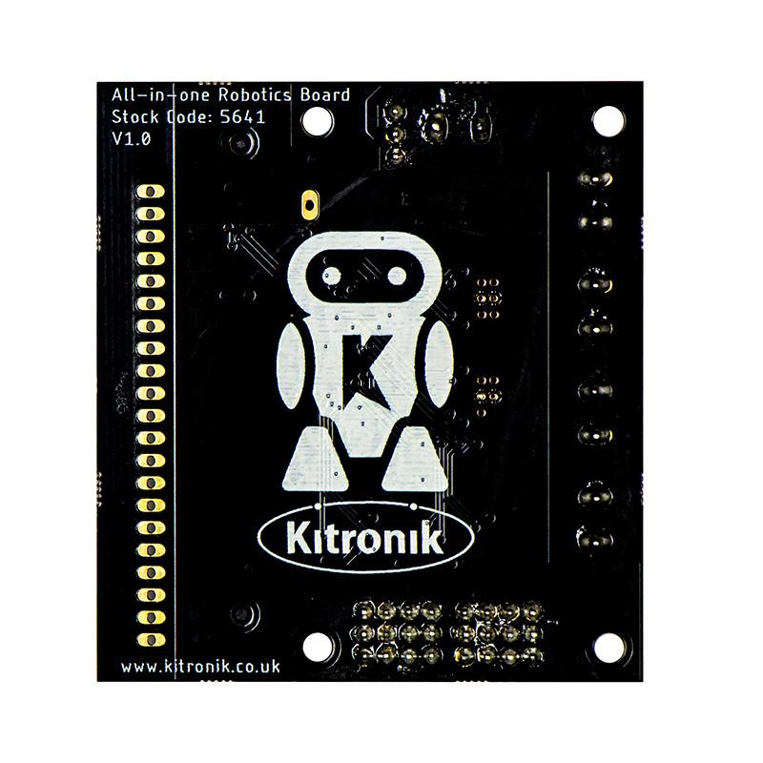

Slide 3
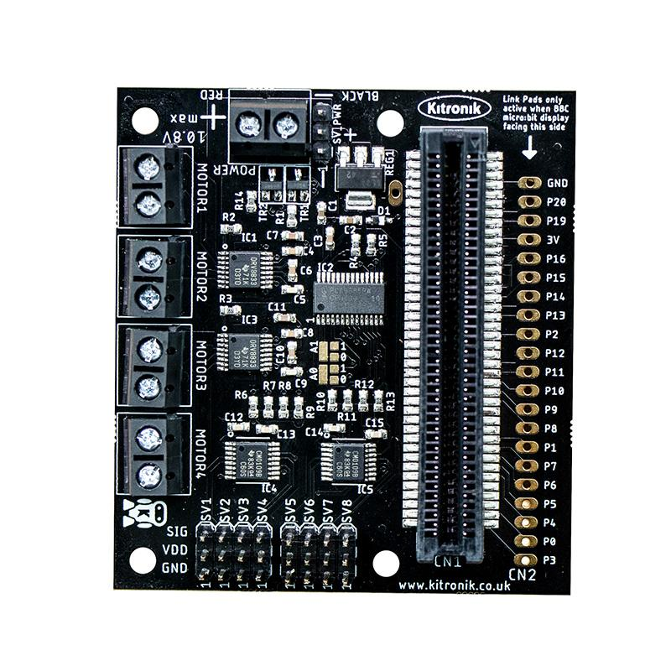
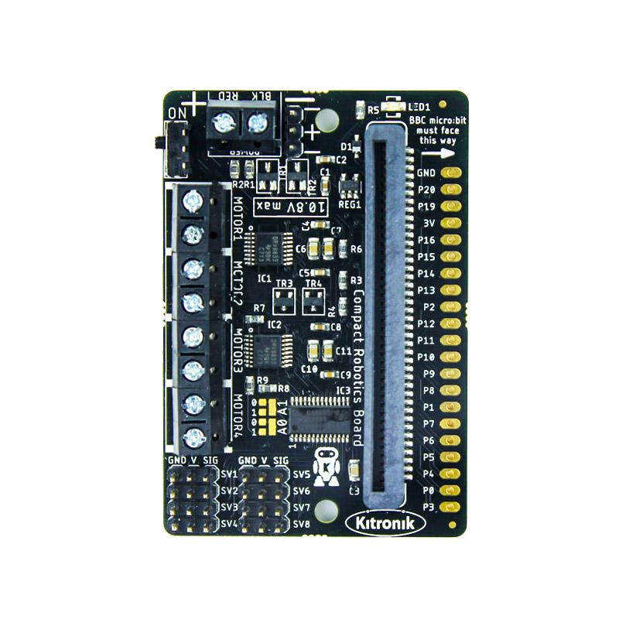

Slide 4





Slide 5
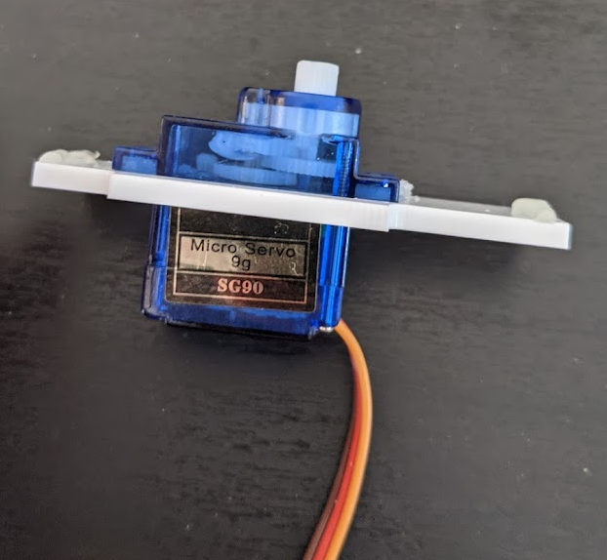
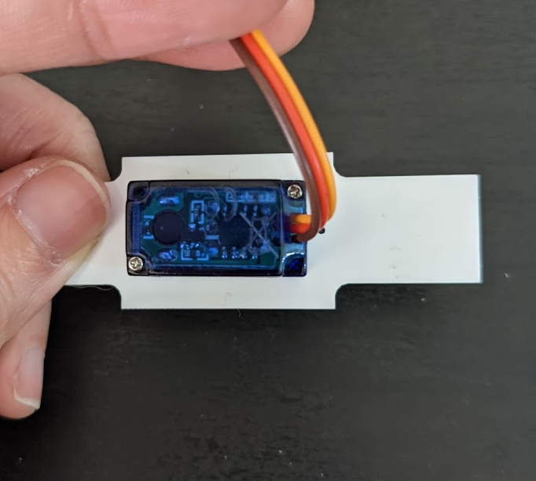
Motor Shaft
Controller board
Gearbox
Wires

Slide 6
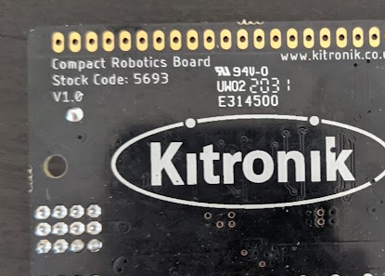
All-in-One Board
Compact Board

Slide 7
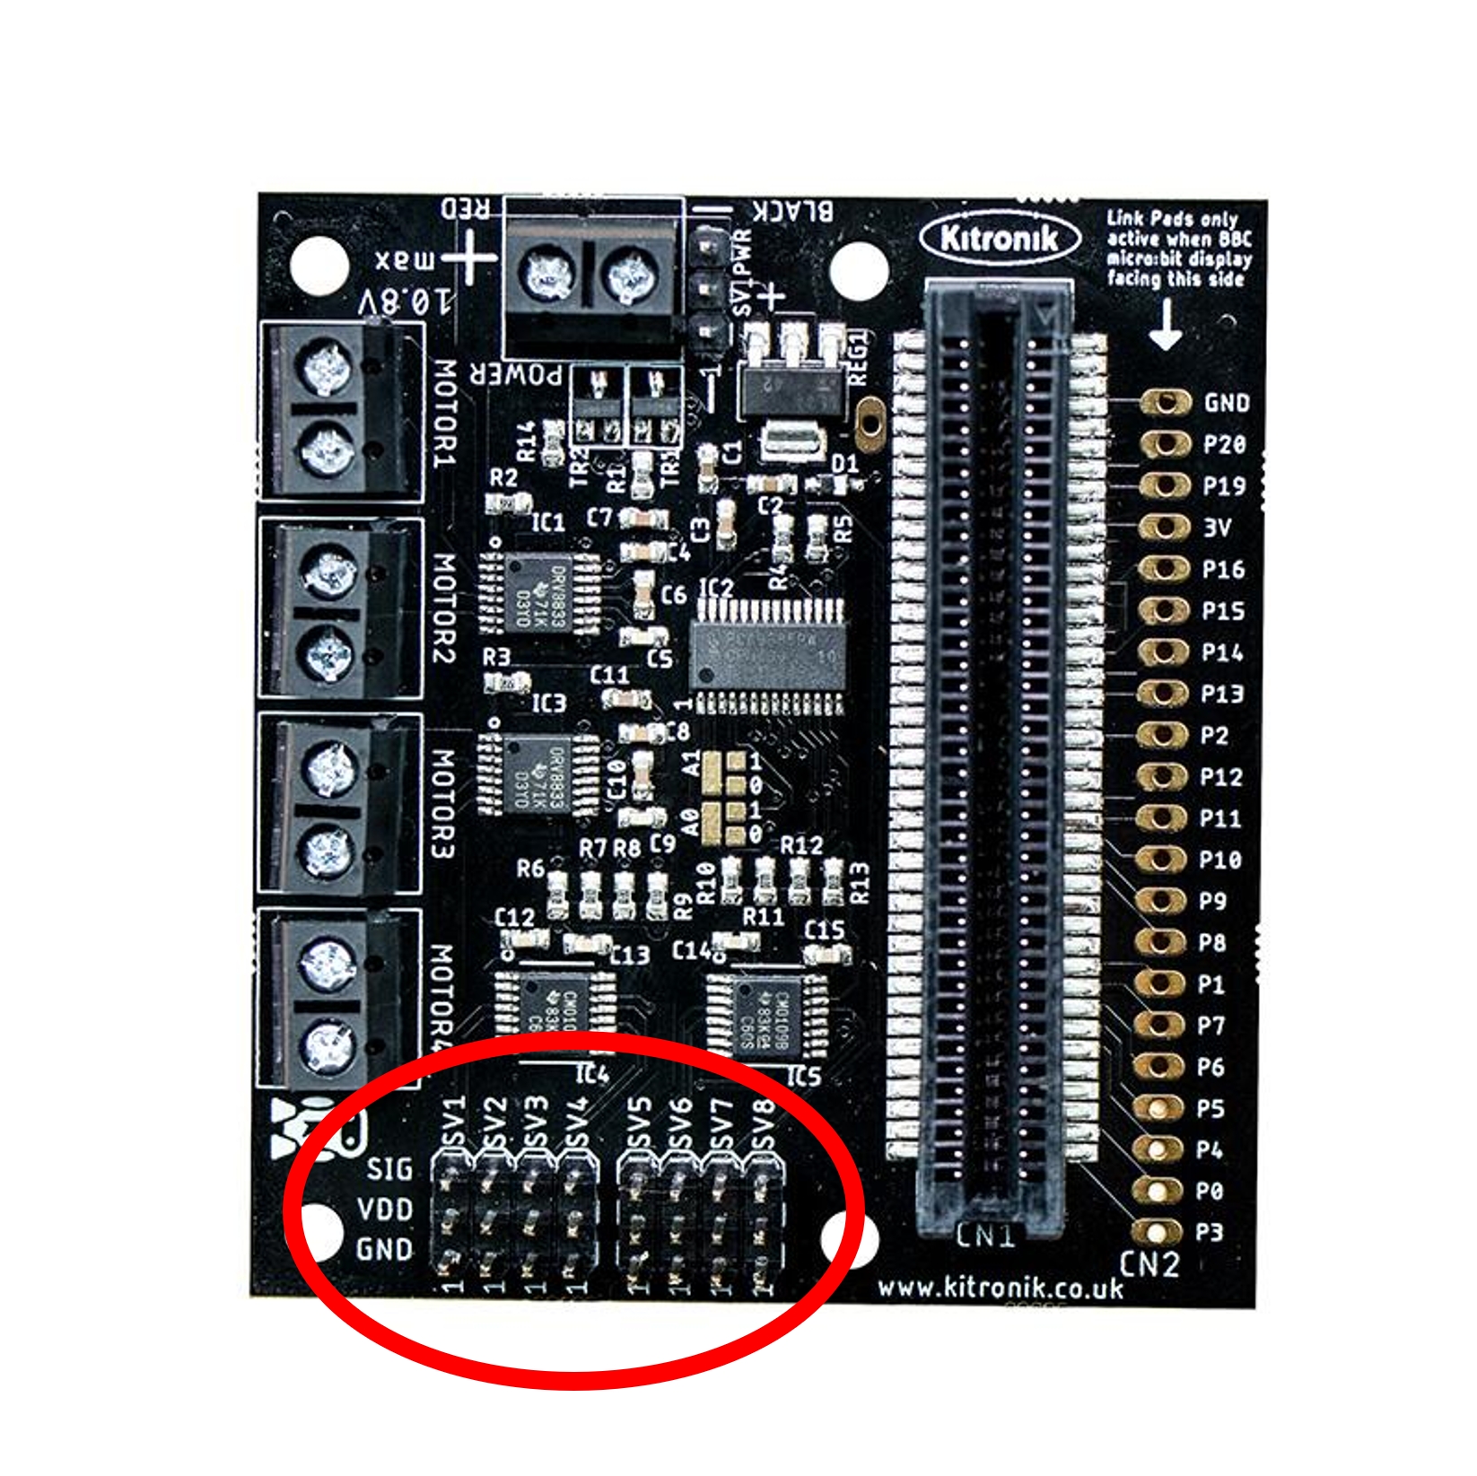
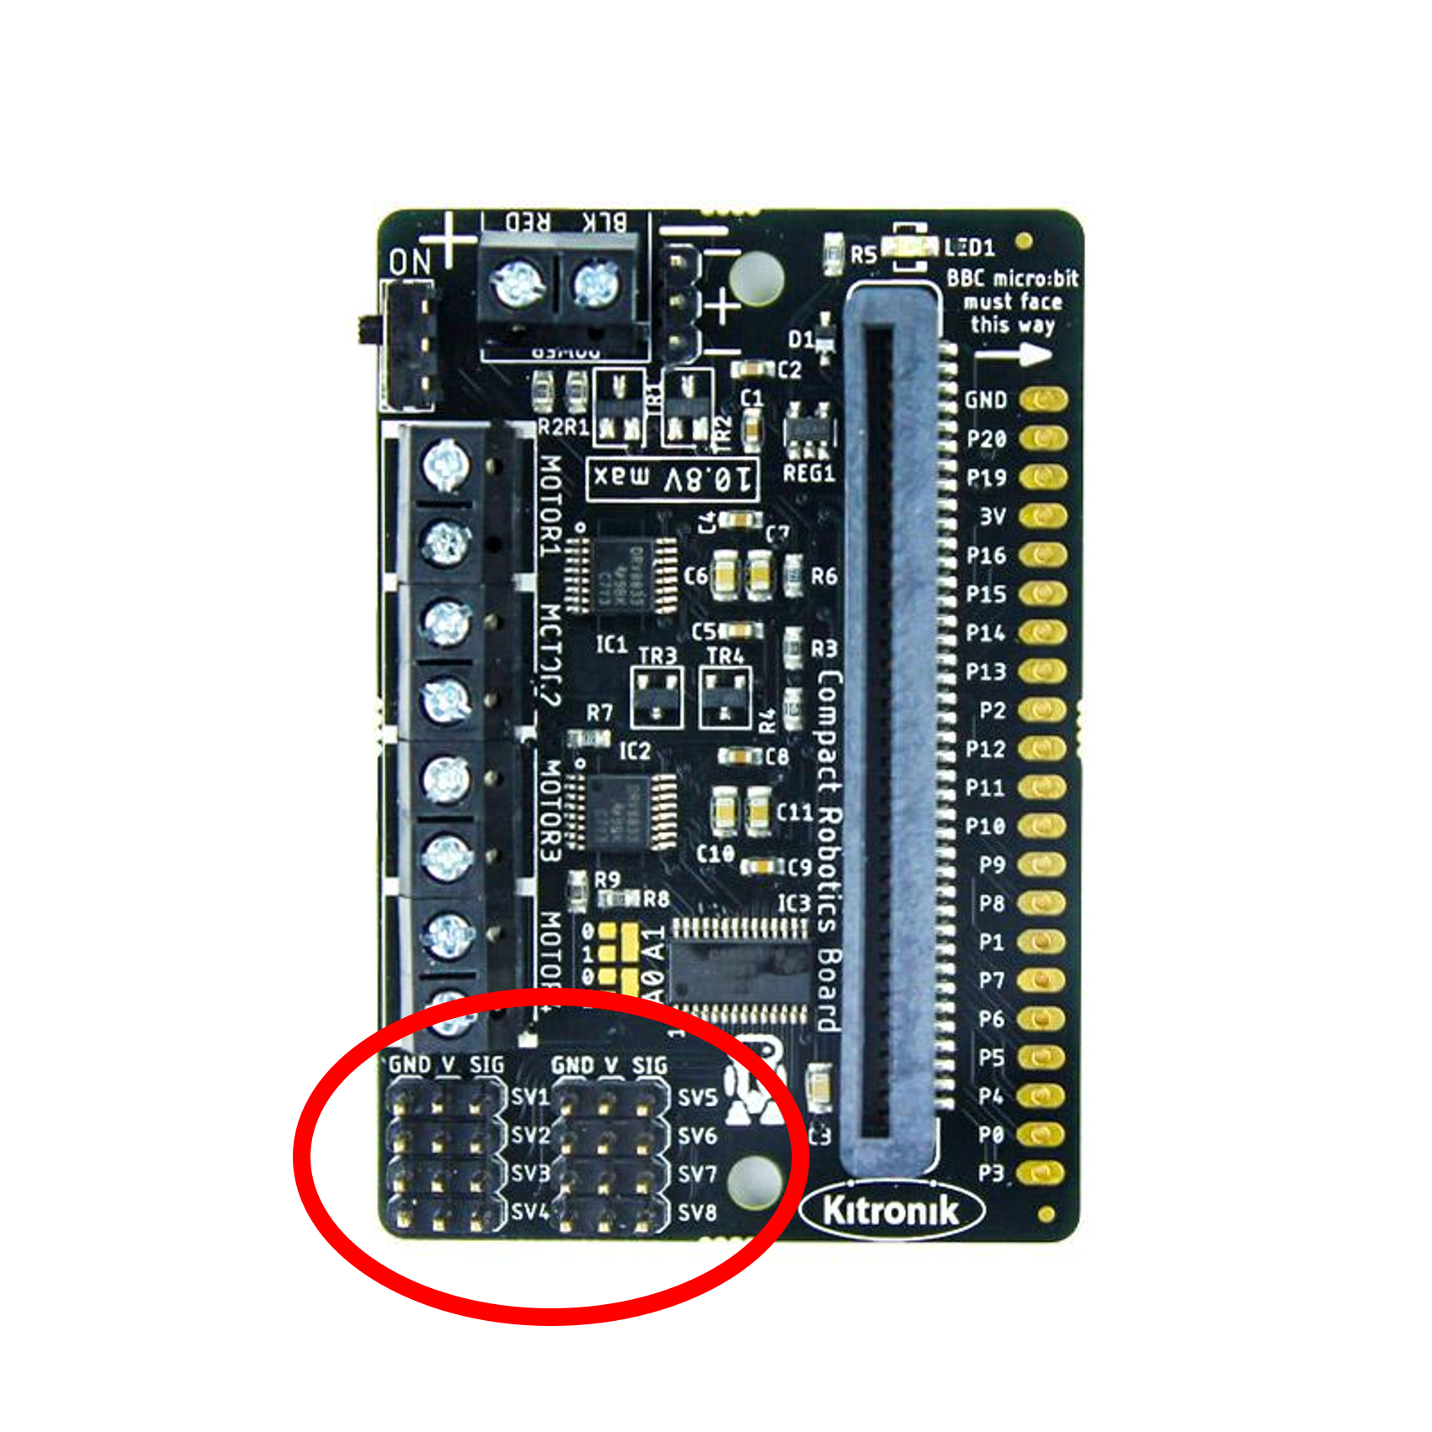
All-in-One Board
Compact Board

Slide 8
All-in-One Board
Compact Board

Slide 9
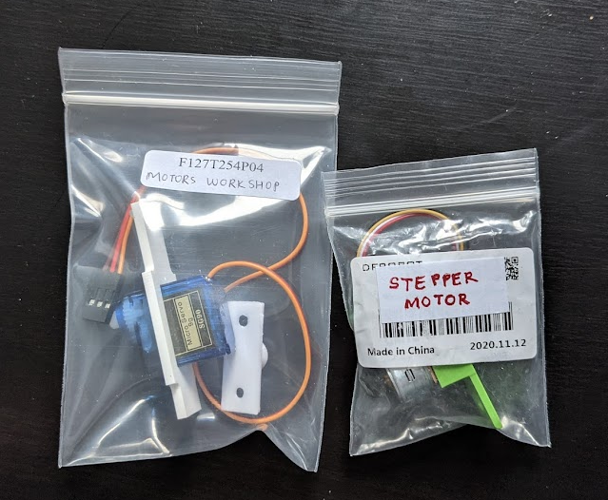

Slide 10
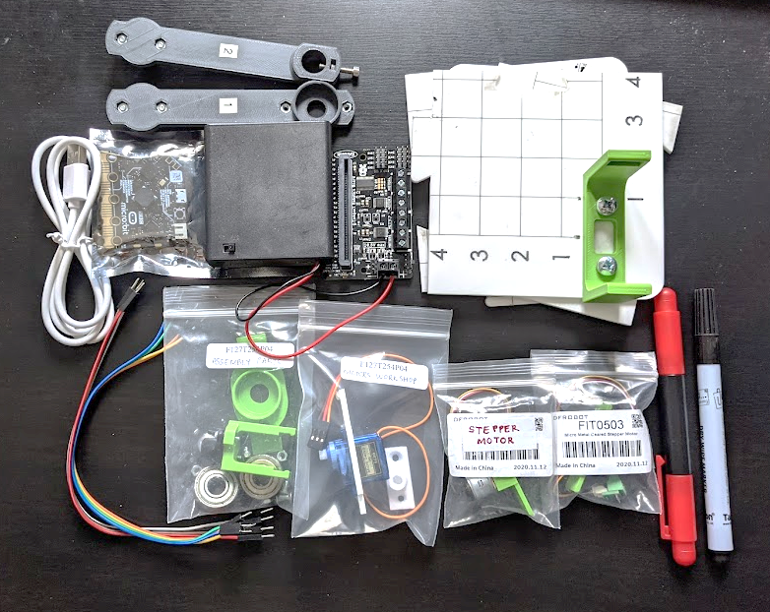
Robot Arms
AA 4x battery holder + Robotics Board
Base Board
Microbit
Screwdriver
USB Cable
Whiteboard marker
Jumper Cables
Motors Workshop bag
Stepper Motors
Assembly Parts bag

Slide 11
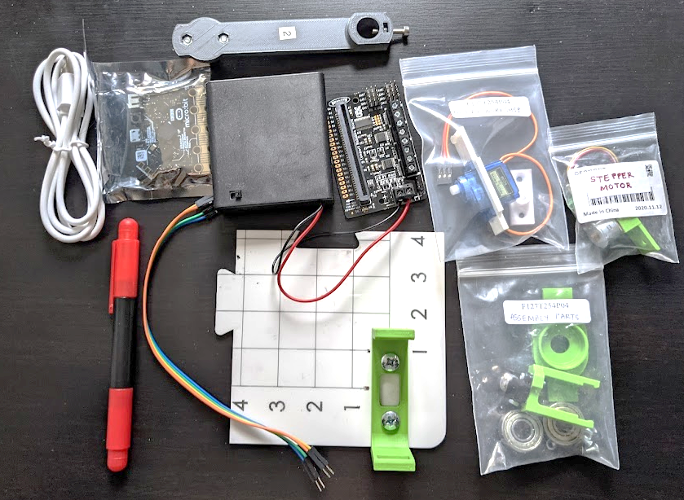
AA 4x battery holder + Robotics Board
Robot Arm 2
Microbit
Motors Workshop bag
USB Cable
Stepper Motor
Screwdriver
Assembly Parts bag
Jumper Cable
Base Board

Slide 12
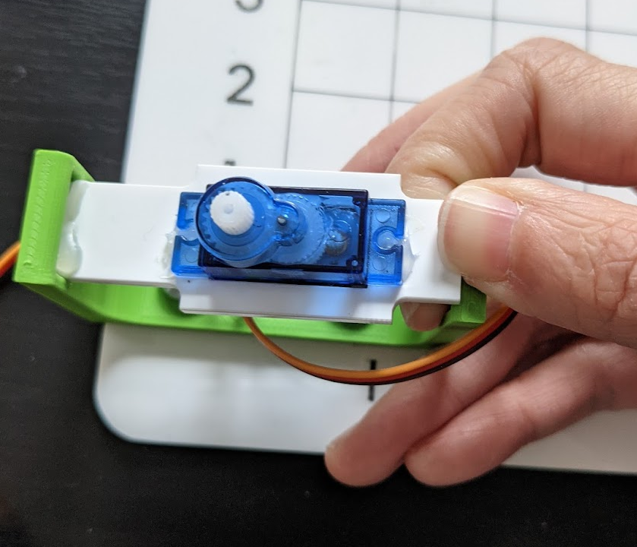
Gently push in
Slot in

Slide 13
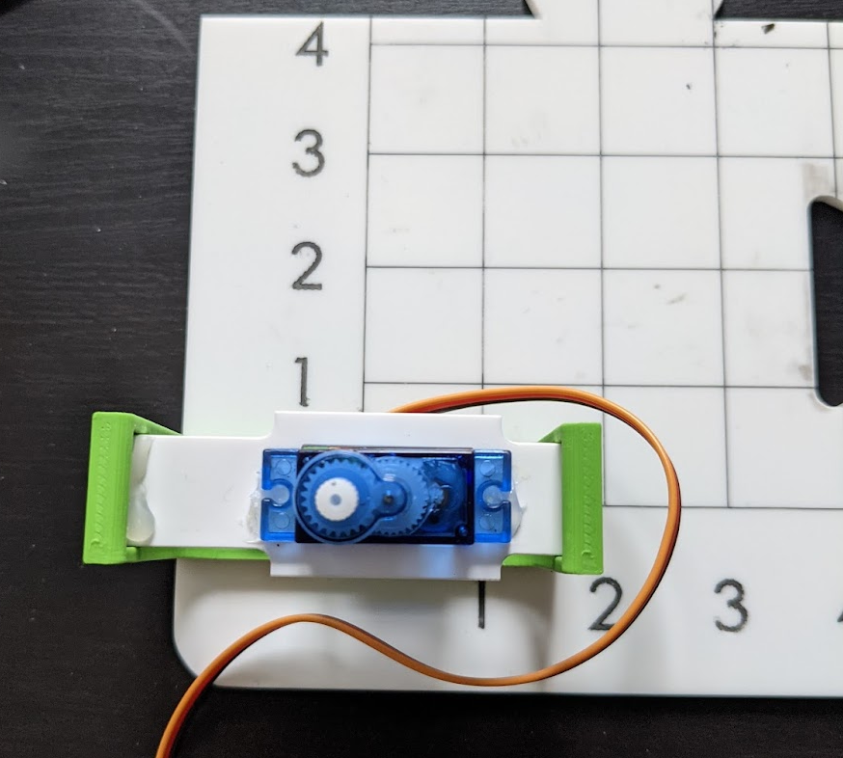

Slide 14
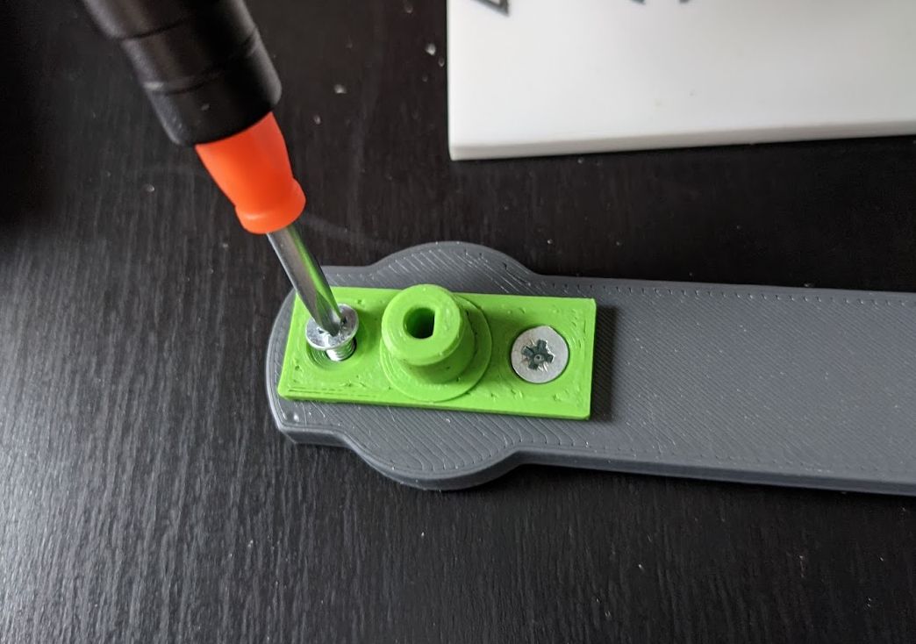

Slide 15
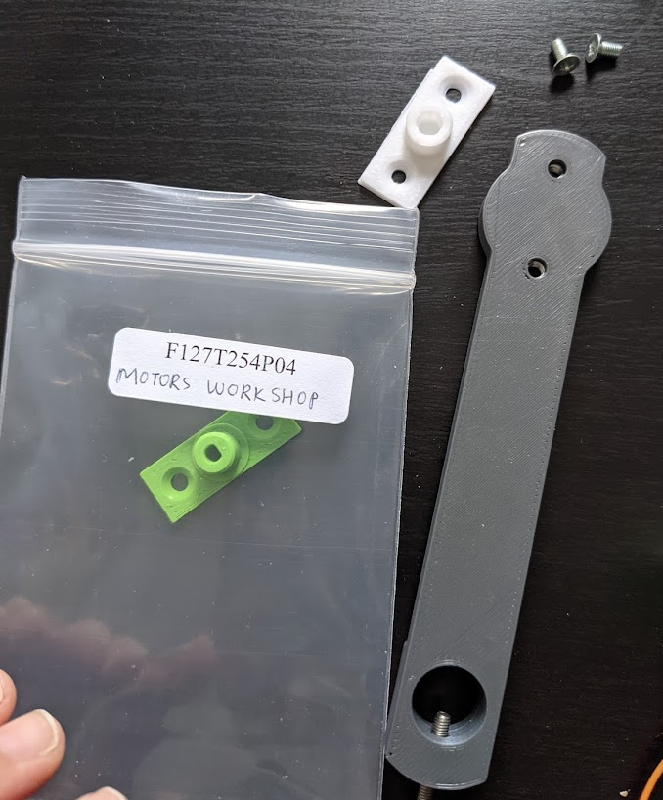
Round shape hole attachment attach to arm
D-shape hole attachment into bag

Slide 16
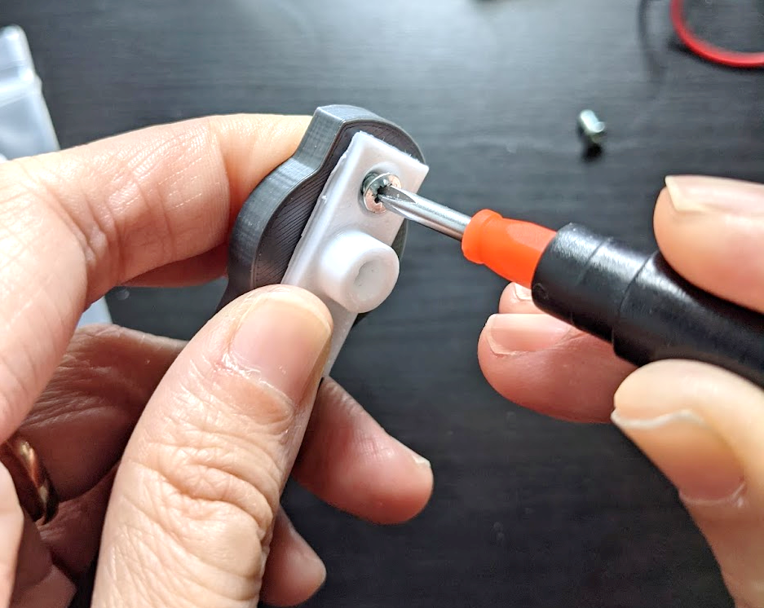
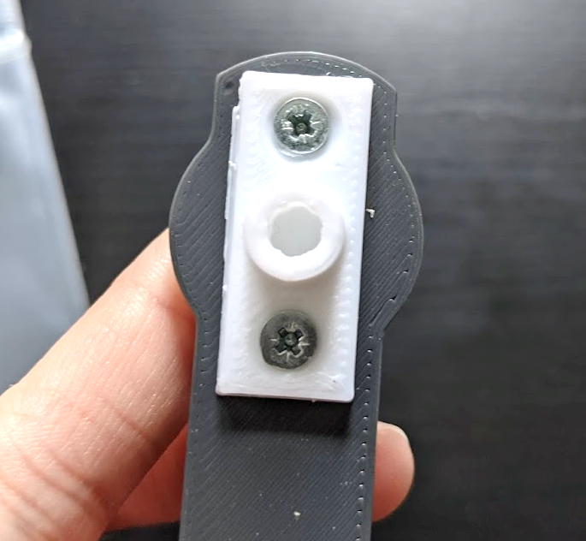
Put your finger to hold the nut in place

Slide 17
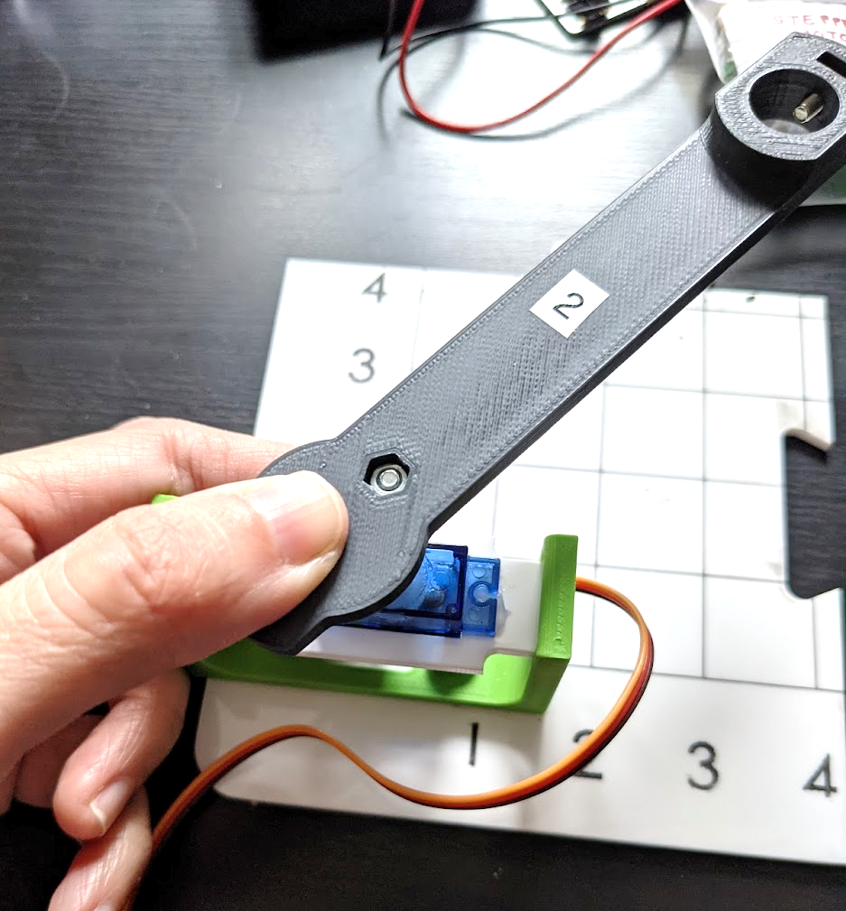

Slide 18
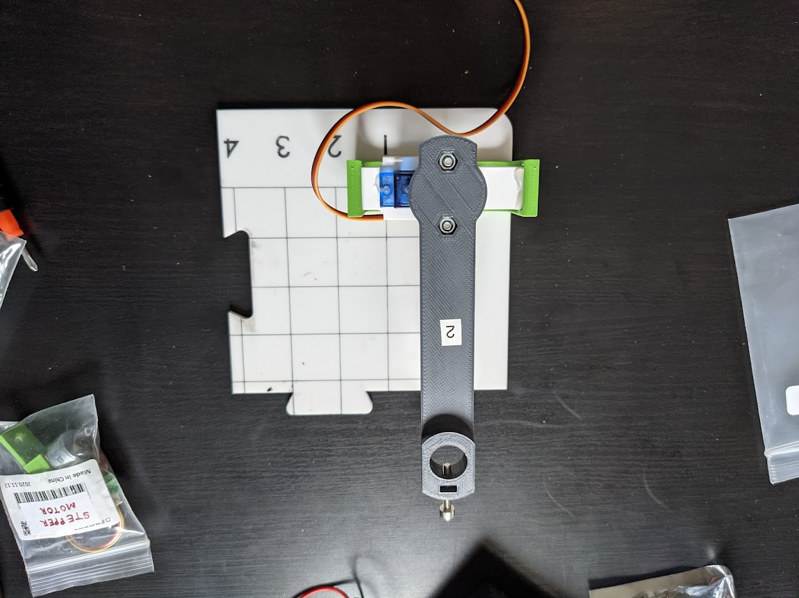

Slide 19
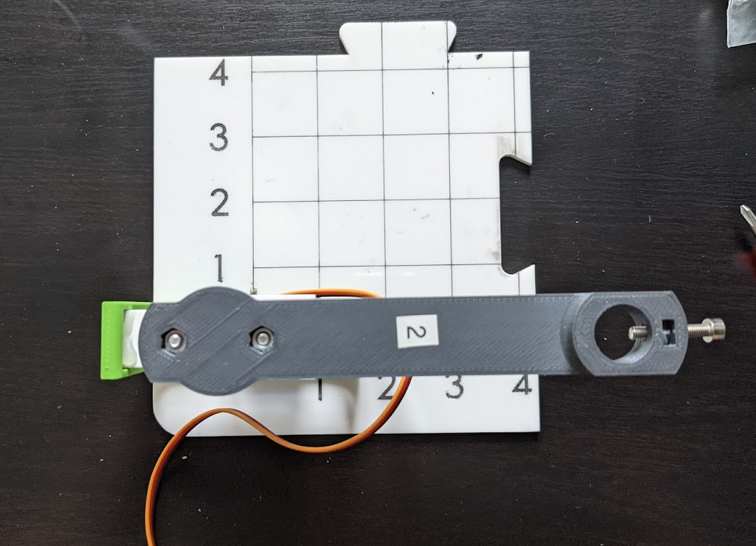

Slide 20
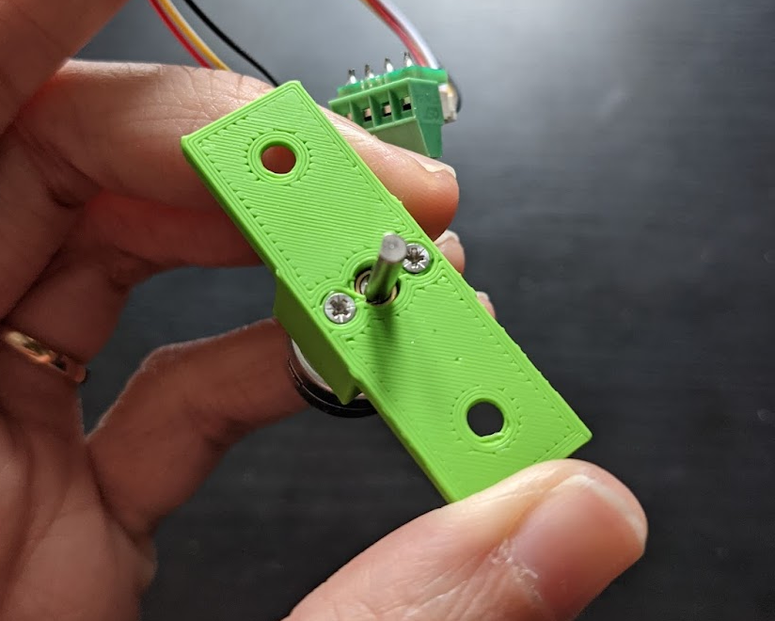

Slide 21
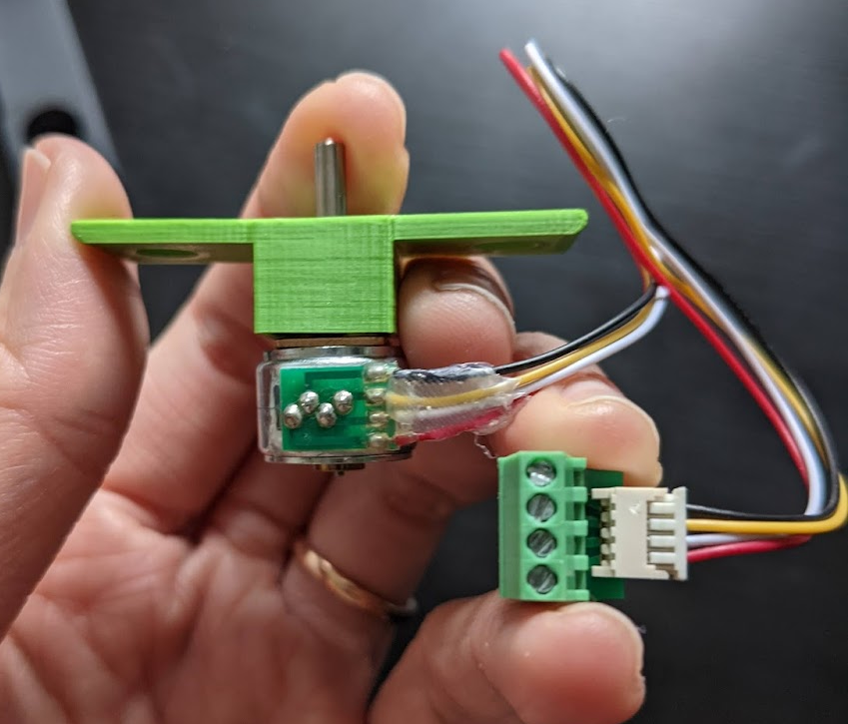
Motor Shaft
Gearbox (inside)
Wires
Motor Body
Motor Extension

Slide 22
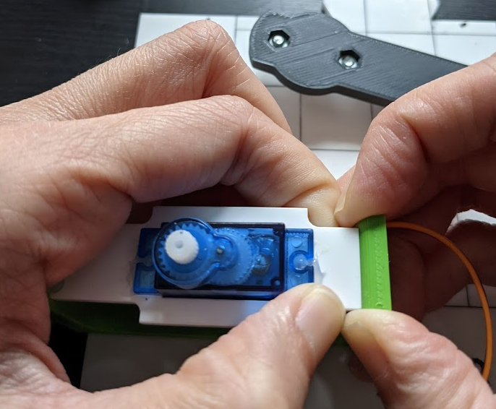
Gently pull it out

Slide 23
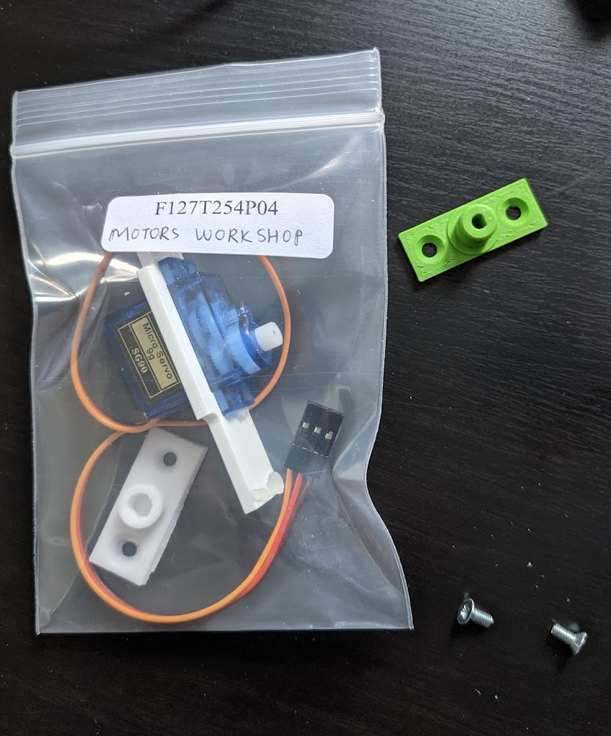
Take the D-shape hole attachment out
Put the servomotor and attachment back into the bag
Careful with the screws!

Slide 24
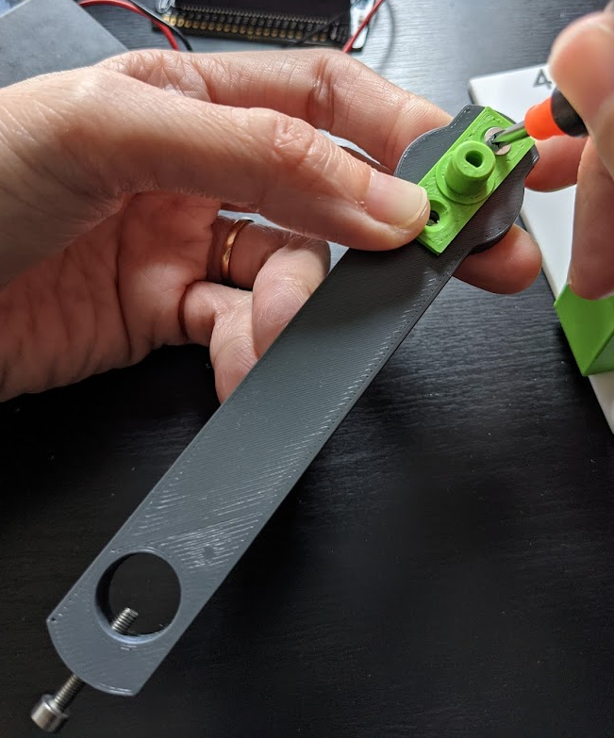
Flat side of D in this direction!

